Slide 1
Topic
“Detecting Derogatory Comments On Women Using Transformer Models”
TEAM-06
Md. Nazrul Islam- 19301124
Tahsina Tajrim Oishi- 20101394
Sara Jerin Prithila - 21101306
Fariha Hasan Tonima - 23341078
Ehsanur Rahman Rhythm (ST)
Adib Muhammad Amit (RA)
1

Slide 2

INTRODUCTION
Increase in rate of cybercrimes, including hate speech and bullying.
Difficulty in detecting derogatory comments due to different linguistic features.
Women facing hatred for stereotypical mindset of people.
Attempting to prevent this offensive action by detecting the hate speech.
Focusing on Bangla and English comments by analysing the datasets.
2

Slide 3
LITERATURE SURVEY
Rabib et al. (2022) portrayed the identification of gender discrimination-based cyberbullying in the understuffed Bangla language.
Khurana et al., (2022) discuss how common internet hate speech is and how automated detection technology has to progress.
Das et al., (2022) highlighted the offensive remarks left on social media sites like Twitter and Facebook.
Karim et al., (2021) stated that as freedom of expression on social media increases, it also brings anti-social behaviors like harassment, hate speech, and cyberbullying.
Isaksen et al., (2020) portrayed the significance of detecting hateful and offensive language online.
Yen et al., (2021) mentioned the obstacles and solutions to hate speech detection.
3

Slide 4
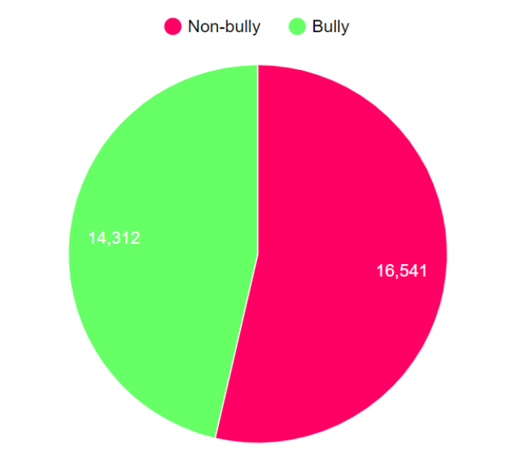
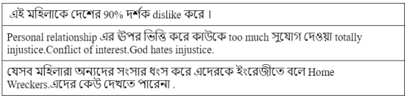
COLLECTED DATASETS
Bangla Language Dataset (30,853)
English Language Dataset (15,138)
A snapshot of our Bangla dataset
Bangla Datasets’ class distribution
4

Slide 5
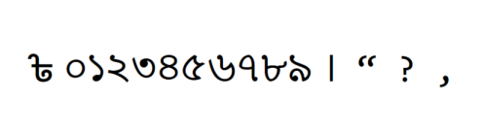
METHODOLOGIES
A. Data Preprocessing B. Data Splitting
Label encoding
Missing and duplicate values
Bangla special characters removal
Case Folding
Different language within Bangla language dataset
Emoji and white space removal
Stop word removal
Tokenization
For English language dataset, we use 20% of the data for testing, and the remaining 80% of the data for training.
For Bangla dataset K-fold split approach was used, with the value of K set to 5.
Bangla Special Character
5

Slide 6
Model Training
Fine tuning is done to improve its performance on the tasks.
Binary classification conducted
Training Arguments class employed to establish arguments for a machine learning model
Transformers library utilized for training and fine-tuning transformers-based model as bert.
To overcome the overfitting issue effective number of epochs are setted
epochs is a critical consideration to provide the model with sufficient opportunities to avoid overfitting issue
Learning rate is too important for potential consequences as it may be too high or excessively low
6

Slide 7
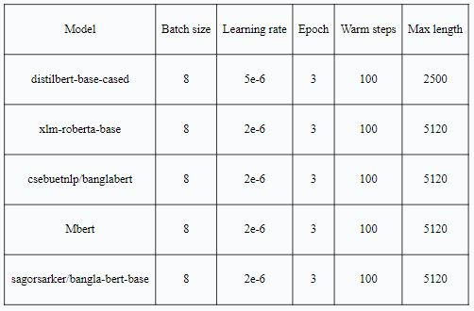
Experimental Setting:
7

Slide 8
Handling Tokens in the Model
A special token called classification token, [cls], was introduced.
Tokenizer inserts [cls] at the beginning of the input sequence before tokenizing.
The layers to prediction are as follows:
Embedding layer
Encoding layer
Multi-head self attention mechanism
Feed-forward layer/mechanism
Linear layer
Softmax function
Prediction
Weight and biases are adjusted on the training data and then are assigned to the target classes .
8

Slide 9
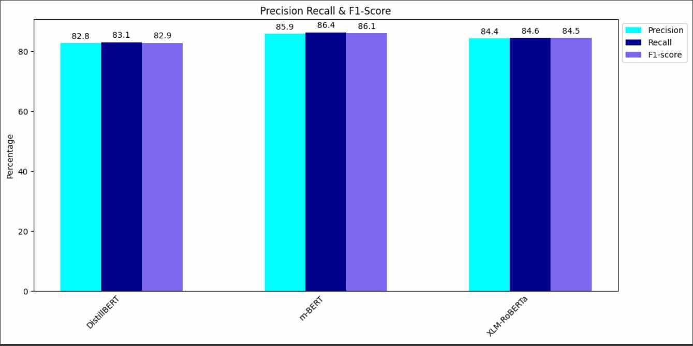
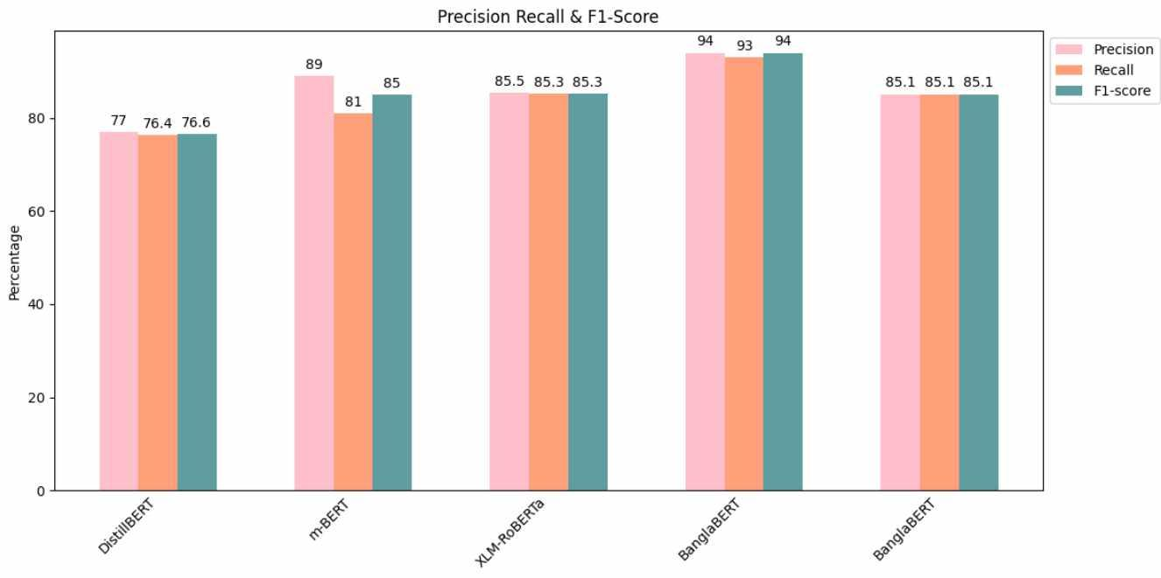
Result and Analysis
01
02
m-BERT model on the English dataset gave the best result with a f1 score of 86.1%.
Among the 5 models trained on the Bengali dataset, Bangla-BERT-base model scored the highest F1 score of 94%.
03
From the graph, we can analyse the difference between the precision, recall and f1 score.
04
Comparison with a past paper, an increase of 8% was seen with our dataset using the Bangla-BERT-base model.
9

Slide 10
CONCLUSION
The research paper was able to capture the topic it was focusing on.
The transformer models showed pretty good results when trained across our large corpora on both English and Bengali datasets.
Pre-trained transformer models are preferred since it has contextual understanding of a text in complicated languages.
For future work we would like to introduce a paper on a hybrid transformer model and make use of it in detecting hate speech.
10

Slide 11
THANK YOU!
11

